Slide 1

Monday Blues
Have you got the Blues?

Slide 2
Monday Blues
Check out: the Monday Blues group

Slide 3



Monday Blues

Slide 4


Monday Blues

Slide 5
Monday Blues
We meet monthly on: a Monday 2.30 – 4.30 p.m. (either 3rd or last)
on Zoom (technical help available)

Slide 6



Monday Blues

Slide 7


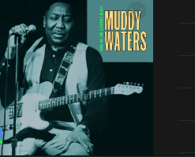
Monday Blues

Slide 8


Monday Blues
* Monday Blues is a small friendly group
* We compile playlists from YouTube
* Some members make presentations

Slide 9


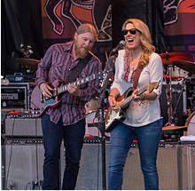

Monday Blues
Welcomes new members

Slide 10

Monday Blues
Want to hear some more Blues?
Then join us now.
Contact details on u3a group listings (Newsletter & Website)

